Slide 1
Huawei Storage: A Technology Deep Dive Boston Storage Solution Group April 2020
Notes:
Good morning, good evening and good afternoon everyone.
Welcome to Huawei Storage Technology Deep Dive.
This is Nelson Liao, the VP of Technologies at Santa Clara Storage Lab, which is also part of the Futurewei Boston Storage Center. It’s my honor to host today’s deep dive session. Before

Slide 2

OceanStor Dorado V6 Storage Highlights
Ever Fast
Ever Solid
AI-Powered
Industry's highest performance and lowest latency
SmartMatrix fully-interconnected architecture for always-on applications
Intelligent full-lifecycle management with AI chips and algorithms
20 million IOPS
0.1 ms latency
Tolerates failure of 7 out of 8 controllers
AI-enabled O&M
OceanStor Dorado
Storage Features
OceanStor 100D
Performance
Usability
Data Management
Reliability
Notes:
Performance, Reliability and Intelligent are cornerstones of our next generation of AFA storage system.
OceanStor Dorado V6 provides 20 million IOPS and 0.1 millisecond latency for faster service processing than ever. OceanStor Dorado V6 tolerates the failure of seven out of eight controllers for the highest level of reliability ever seen in the industry enabled by unique and innovative SmartMatrix Architecture. It is an industry feat for reliability. Our competitor can only survive 1 or 2 controller failures.
Finally, OceanStor Dorado V6 offers AI-powered O&M for intelligent, simplified resource usage and management and AI powered intelligent cache made it possible by home made AI chips.
Q: RDMA as interconnection for its low latency and high throughput is getting hot & popular. Why does Huawei choose to support NVMe over FC first instead of NVMEe over RDMA network?

Slide 3

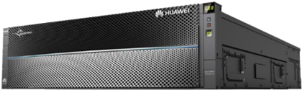



OceanStor 100D Storage Highlights
One Data Center, One Storage | Data Migration Free | Data Intelligence
SAN/NAS convergence
Convergence of storage systems at all levels
Public cloud gene
Enterprise-class capabilities
Large cluster
Multi-tenancy
Dynamic EC
E2E DIF
Deduplication
Compression
High-ratio EC
I/O aggregation
Heterogeneous storage system convergence
Primary and backup storage system convergence
SSD and HDD convergence
Converged Protocols
Converged Critical Workloads
Converged Scenarios
Converged Clouds
Converged Management
One-stop system deployment reduces E2E TCO by 30% and improves resource utilization
One storage system supports critical and emerging applications
One storage system for data collection, usage, management, backup, and archiving
One platform integrates edge, private, and public clouds
One management platform supports system operations and O&M
OceanStor Dorado
Storage Features
OceanStor 100D
Performance
Usability
Data Management
Reliability
Notes:
OceanStor 100D offers Data center with one migration free storage and data intelligence
OceanStor 100D eliminates the diversity of storage. All-flash storage, high-end storage, mid-range storage, object storage, and scale-out file systems are all different types of nodes in OceanStor 100D, so whether it's critical business, such as databases, virtual machines, or non-critical and new workloads, such as backup. , archive, analytics, and cloud applications can all be deployed on OceanStor 100D to create one data center one storage. By unifying the data center storage infrastructure, business flows are consolidated, efficiency is increased by 50%, and TCO is reduced by 30%
Not like 2 layer architecture of typical distributed storage system, OceanStor 100D’s 3 Layer architectures enables enterprise-class capabilities with cloud like scalabilities and intelligent O&M.
It offers 5 major convergences:
Converged Protocol File, Object, Block, HDFS with native access (industry first native access)
Converged Workload to support various applications from mission critical to emerging applications
Converged Scenarios to support various storage scenarios like big data, management, backup and archiving
Converged Clouds to integrate edge private and public cloud capabilities
Converged Management to support system operations and O&M

Slide 4
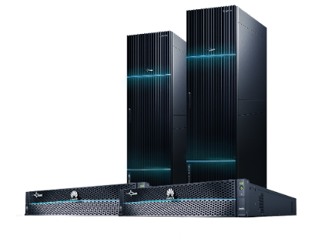
OceanStor Dorado V6 with Rich Enterprise Features
NAS
Global Name Space
True NAS Cluster
High Performance
FlashLink
Smart and Hyper Features
End-to-End NVMe
SmartMatrix
Intelligent Read Cache
RAID 2.0+
Intelligent Front-end Adapter
Smart Global Deduplication
Intelligent DAE and High density DAE
FlashEver
Self-developed Chipsets
OceanStor Dorado
Storage Features
OceanStor
100D
Performance
Usability
Data Management
Reliability
Notes:
In terms of product design, we implemented a number of technological innovations on Dorado V6 to deliver the top 1 performance and reliability in the industry.
Based on our self-developed chips, fully-interconnected hardware architecture, and active-active symmetric software architecture, we achieved the industry's highest 20 million IOPS and 100 microseconds of latency.
In the event of faults such as controller fault or engine fault, our storage systems can switch over services within seconds and ensure zero service interruption based on our reliability enhancement techniques such as SmartMatrix and intelligent interconnect I/O modules.
Moreover, we introduced our own AI chips and smart disk enclosures to implement AI storage.
Our FlashEver program achieves zero data migration in 10 years by upgrading controllers and smart disk enclosures.

Slide 5
OceanStor 100D – Enterprise Class One Storage/One Data Center Solution
Fast
Reliability
Saving
2 Converged critical workloads
Traditional workloads
DB
Emerging workloads
Container, AI, & IoT
3 Converged clouds
Key point 1: Elastic EC
Key point 2: Global Adaptive Deduplication & Compression
Key point 3: FlashLink Acceleration
Key point 4: Across-AZ EC/HyperMetro
Key point 5: Free Data Flow Across Clouds
Public cloud
One DC,
One Storage
1 Converged protocols
File
DB
Block
HDFS
Object
Multi protocol
Edge cloud
4 Converged scenarios
2
Intelligent balancing/copy
Ever-new storage
Data Migration Free
Key point 6: Ever-New Storage, No Data Migration
ARM node
x86 node
Old node
1
New node
3
Old node exits
5 Converged management
DevOps
Production
Backup
DB
CDM
Data Intelligence
Key point 7: Intelligent Operations and Maintenance and Data Lifecycle Management
FusionDJ
Resource
Delivery
Data Flow
Fault
Analysis
Risk
Prediction
Replica
Management
OceanStor Dorado
Storage Features
OceanStor 100D
Performance
Usability
Data Management
Reliability
Notes:
This page is to echoes the five convergence and three customer benefits realized by OceanStor 100D and to lead the seven supporting technologies of OceanStor 100D
There are 7 key technologies inside OceanStor 100D:
Elastic EC to provide high reliability with performance and minimize the cost
Global adaptive dedupe and compression.
FlashLink Algorithm acceleration
Across AZ EC and Hypermetro to provide 6 9s availability
Free Data flow across clouds and different tiers of storage to provide ultimate cost effective data management solution.
Ever new storage without data migration. A one click cluster expansion, storage rebalancing provides customer extra flexibility.
Intelligent O&M and data lifecycle management with DJ and CDM
Q: People generally believes that the thinner the stack, the better the performance, why Huawei storage has three service layers instead of the two layers from our competitors? Is there any impact to the performance? What are the primary benefits?

Slide 6
Importance of Latency and Throughput
Latency
Transaction latency is the core “value metric.”
Importance of “guaranteed” maximum latency.
Storage latency is the most critical factor for all transaction-based workloads such as finance, carrier, manufacturing, and government sectors.
Throughput (Bandwidth, IOPS)
Critical metric when data needs to be streamed rapidly (images and video).
For applications working with large sets of data (backups, oil&gas, HPC, etc.)
Key messages:
OceanStor Dorado V6: ultra-low latency (0.1ms), high throughput (20 million IOPS)
OceanStor 100D: good latency (0.5ms), ultra-high throughput.
OceanStor Dorado
Storage Features
OceanStor 100D
Performance
Usability
Data Management
Reliability
Notes:
Latency
Database transaction often consists of multiple serialized read/write operations.
It is critical to overall application performance to keep latency of each operation as small as possible.
“Guaranteed” maximum latency allows customer applications to predict application response time.
Transaction based workloads are very common in industry. OceanStor Dorado is highly optimized for this type.
Throughput
Another set of typical storage applications is throughput sensitive applications.
They range from image/video streaming to backups and large data set analyses.
For these kind of applications throughput is very important storage metric.
Both OceanStor Dorado and 100D has very high throughput, they are the leading product
In enterprise storage and distributed storage systems. 100D has particularly high scalability.

Slide 7
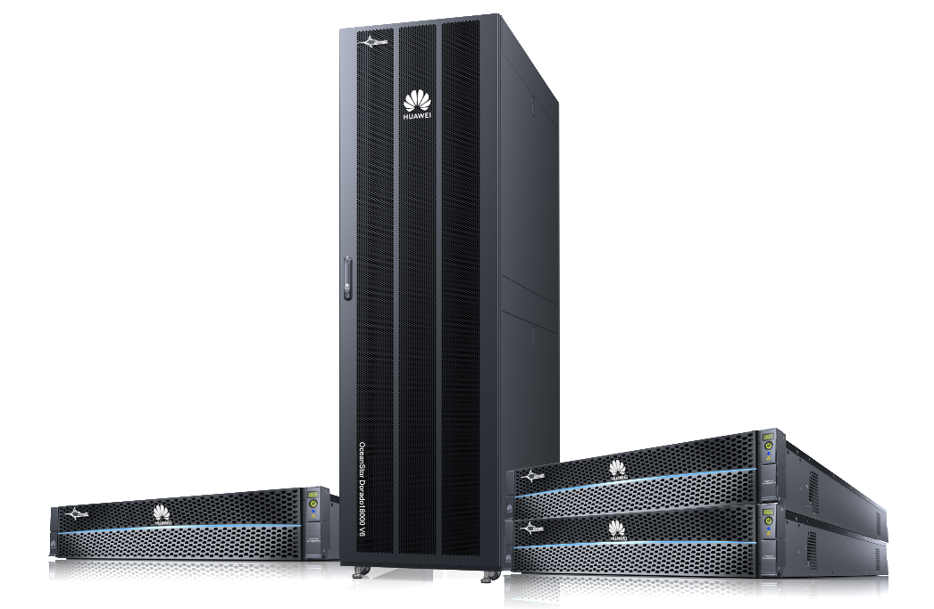
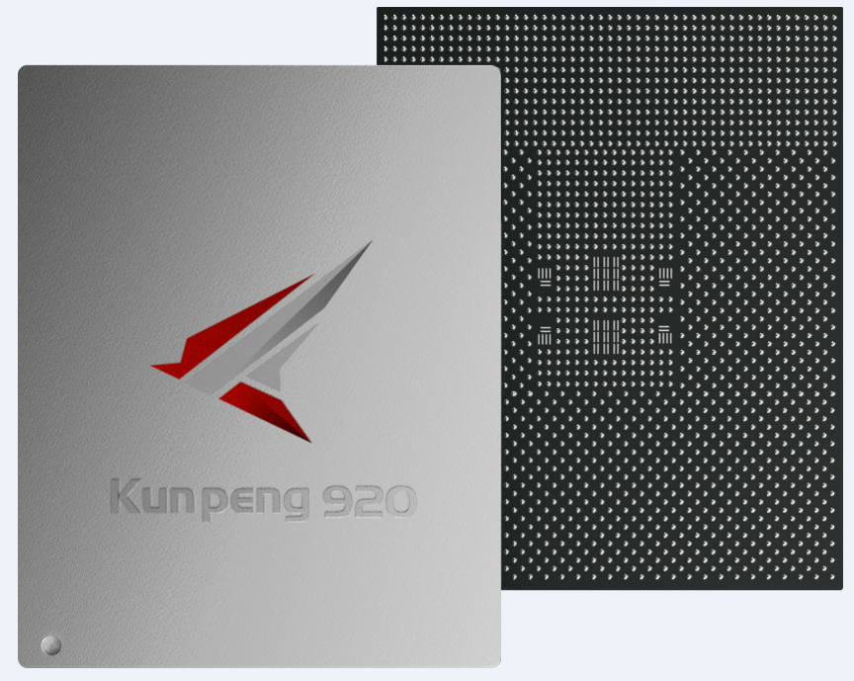

Hardware/Software Innovation - Powered Platforms for Fastest AFA
Hardware-powered
Seamless storage upgrades for industry-leading performance
Protocol-leading
Industry's highest performance
E2E NVMe for a high-performance expressway
Algorithm-accelerated
FlashLink®
SSD-controller synergy with intelligent algorithms for maximized all-flash performance
OceanStor Dorado
Storage Features
OceanStor 100D
Performance
Usability
Data Management
Reliability
Notes:
SPC-1 is a standard benchmark commonly used to measure storage system performance. The SPC-1 benchmark directly reflects the capabilities of storage systems in various scenarios.
The latest SPC-1 benchmark results show that our OceanStor Dorado V6 high-end storage provides 20 million IOPS and 0.1 millisecond ultra-low latency. This performance doubles the performance of next-leading competitor.
The high performance is the result of our continuous innovations in hardware, protocols, and software algorithms.
1 Our NIC with offload capability improve 2x improved latency (160us to 80us)
Front-end NIC. It has TOE capability to offload a lot of network protocol processing from CPU. It reduces controller CPU workloads and enhances overall performance.
Currently, this NIC features an industry-leading 8/16/32GB FC and 10/25GE/40GE/100GE support.
2 Kunpeng 920 processor with high core density with 2x higher performance than comparable x86
It delivers 25% more computing power than comparable Intel CPUs and greatly improve our storage performance. If 4 processors are deployed to a controller, an OceanStor Dorado V6 high-end system with 4 controllers has 16 processors with 192 cores each controller.
3 AI chip(Ascend 310) powered intelligent cache to improve 50% cache read hit ration for VDI and other workloads
AI chip was designed to make our storage system more intelligent. AI chip automatically captures nature of workload. It learns and analyzes its rules to predict possible follow-up actions and prefetches necessary data to the read cache. It greatly improves the read cache hit ratio, especially in batch read scenarios.
4 SSD controller improve 2x write latency
The SSD controller optimizes core FTL algorithm to boost every SSD's performance.
It accelerates reads and writes on our NVMe SSDs and reduces latency. Lab tests of light workloads indicate that reads and writes on a single SSD are 15% faster than those of competitors. It’s mluti-stream support greatly reduces write amp and the need of garbage collection.
BMC management chip for efficient management of storage controller components.
Its built-in library contains more than 10 years of storage fault modes to quickly identify and rectify faults. This chip speeds up component fault locating and offers immediate error correction solutions, bringing fault locating accuracy up from 60% to 93%.
Dorado product line is the industry first end-to-end NVMe AFA storage system.
5 NVMe provides reliable NVMe commands and data transmission. NVMe over Fabrics can extend NVMe to various storage networks and protect customer existing investments. It reduces overhead in processing storage network protocol stacks and achieves high concurrency and low latency for applications.
To calculated the 0.1 millisecond latency. We use a typical database model, a single LUN, and a single concurrency for the test. The read/write ratio is 7 to 3, read latency is 130 microseconds, and write latency is 50 microseconds. So the overall system latency is 106 microseconds.
We use our self-developed ASIC interface modules, SSDs, and enclosures to provide full support for NVMe. We have built high-speed NVMe channels with our unique designs in protocol parsing, I/O forwarding, service priority, and hardware acceleration over the channels.
6 What's so innovative about the algorithms on OceanStor Dorado V6?
a) Dorado FlashLink algorithms implement a series of software algorithms to collaborate with various storage hardware
To harvest Kunpeng processors’s mass core density, Dorado designs a specialized multicore scheduling algorithm and is able to double storage computing power.
b)Kunpeng processors in smart SSD enclosures collaborates with backend module to offload disk reconstruction services. This speeds up reconstruction by 20 times as compared with HDDs.
c)AI chips partner with the intelligent cache algorithm so that the system can predict application workload patterns and be able to prefetch data to cache. It improves the cache hit ratio by 50%.
d)Full-stripe writes reduce write amplification.
e)Multi-streaming technology reduces garbage collection by separating metadata and other data.
f)I/Os are assigned different priorities for resources to deliver stable and low latency.

Slide 8
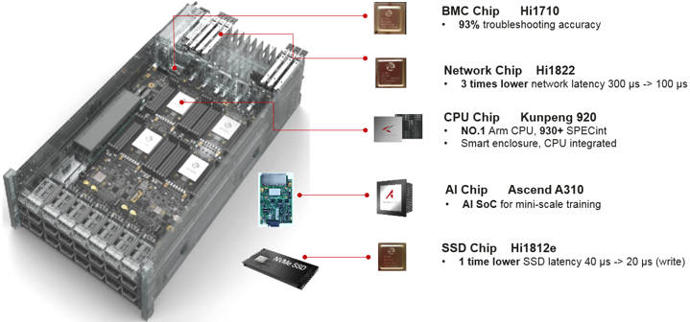
Dorado V6 Offers Leading Performance for Enterprise
SPC-1 benchmark: 20 million IOPS and 0.1 millisecond ultra-low latency.
Huawei's unique SmartMatrix architecture implements point-to-point interconnection, cluster-level resource sharing and scheduling to achieve symmetric active-active processing and ultra-low end-to-end latency.
FlashLink® performance acceleration technology differentiates Huawei from the competition.
Collaboration between controllers and disks effectively reduces write amplification, ensuring consistent low latency, large throughput and stable performance when multiple features are used concurrently.
Huawei-developed chips for
front-end interconnection
CPU processing
Cluster switching
Back-end interconnection
Disk controllers
providing low latency and large throughput for end to end solution.
OceanStor Dorado
Storage Features
OceanStor 100D
Performance
Usability
Data Management
Reliability
Notes:
Dorado V6 designed to carry mission-critical services.
0.1ms comes from test model: 7:3 read/write, 130 μs read latency, 50 μs write latency
Time = 130 x 0.7 + 50 x 0.3 = 106 μs
Tested on NVMe AFA, significantly shorter path between host and storage
System has unique high performant architecture designed to achieve low end-to-end latency and high throughput.
In house hardware is a major differentiator.
Ability to optimize end-to–end stack give Huawei huge advantage.
All embedded technologies is highly integrated and designed to operate at there best capability.

Slide 9
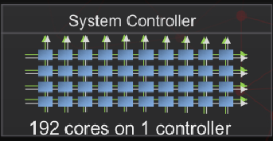

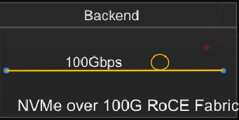
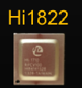
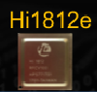
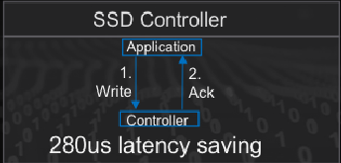
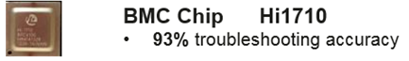
Flashlink™ Self-developed Key Hardware
High Perf
High speed 100Gps.
Low latency
RDMA/FC/Eth/InfiniB/TCP
0.5ms consistent latency
3M hr MTBF, highest in industry
Local wear leveling
Bad block mgmt.
Data Redundancy
Background inspection
Full SAS/NVMe support
16TFLOPs computing pwr
Good for inline AI help for caching & dedup
Sensor Monitoring
Error diagnostics
OceanStor Dorado
Storage Features
OceanStor 100D
Performance
Usability
Data Management
Reliability
Notes:
Good storage solution is to provide high and reliable data storage service. Performance, reliability, life time and economical factor are major concern from customers.
Oceanstore Dorado V6 lays a solid foundation upon HW proprietary chips and from there build up sophisticated but flexible infrastructure to answer various customer need.

Slide 10
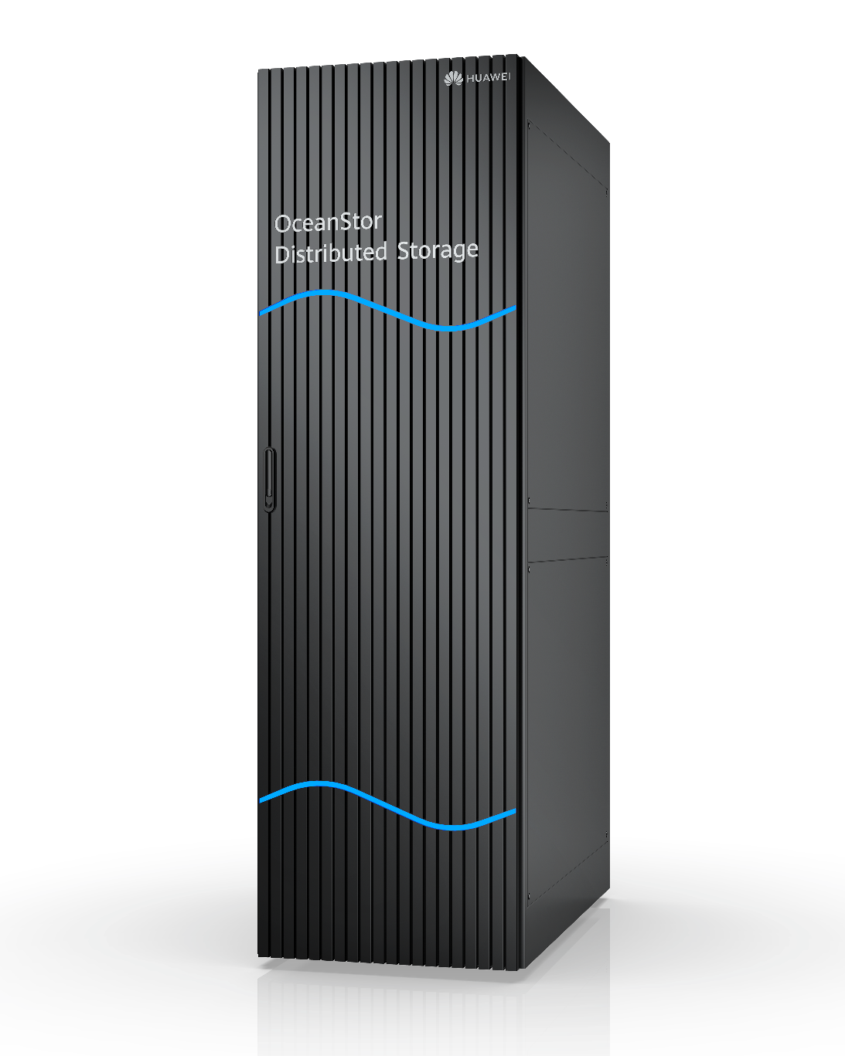

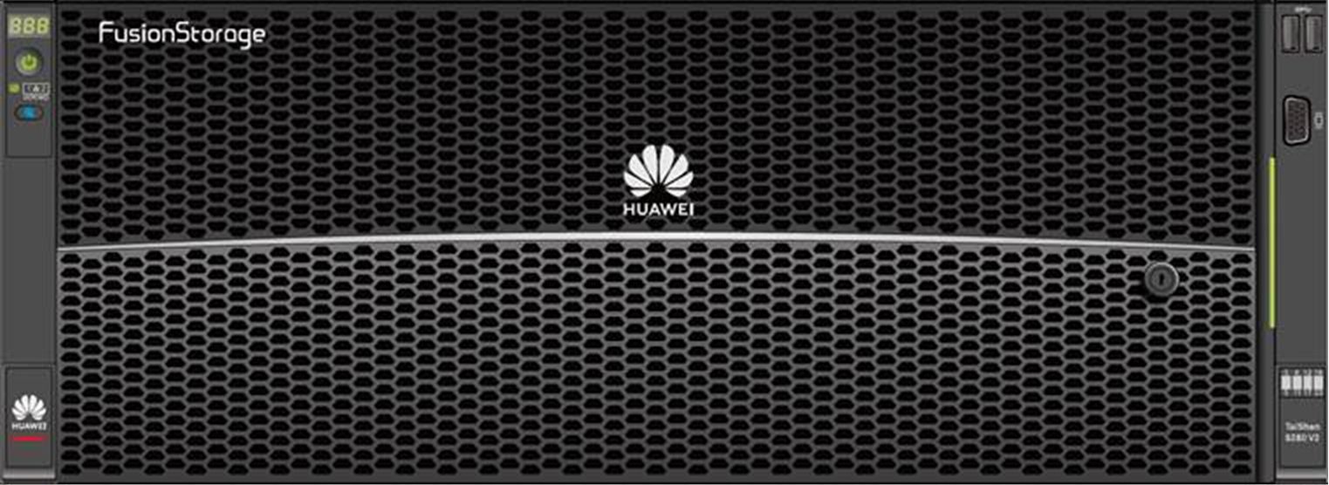
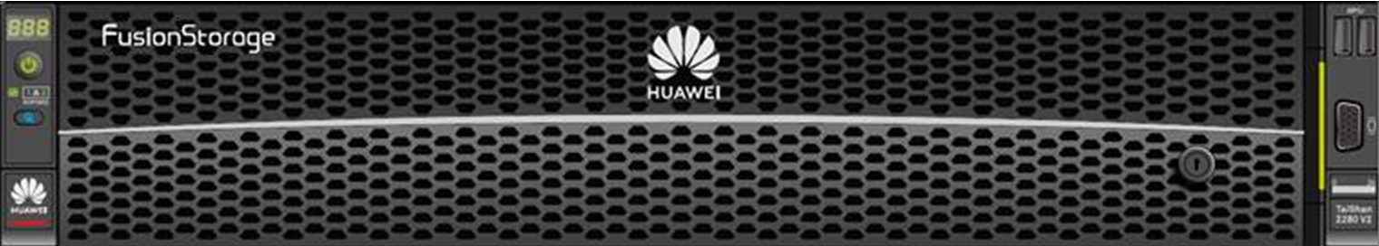

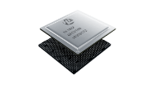
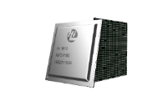
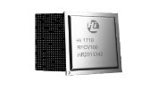
OceanStor 100D Performance, Scalability and Versatility
Industry leading distributed storage systems with up to 4096 nodes and 576PB in a single cluster.
Support all popular storage interface and scenarios.
Full stack optimized for best performance in the same category: sub 1ms latency under stress, millions of IOPS per cluster.
File
HDFS
Object
Block
Services
Full
Stack
Nodes
OceanStor
Capacity
OceanStor
All-Flash
OceanStor
Performance
Chips
Compute
Transmission
Storage
Management
OceanStor Dorado
Storage Features
OceanStor 100D
Performance
Usability
Data Management
Reliability
Notes:
Single cluster size limit: 4096 nodes, 576PB
Intelligent CPU partition and lockless design resulted in highly predictable latency and best performance.
Stable 0.5ms latency for business critical app, under 1ms latency and 4.5 million IOPS for transactional DB access under heavy load.
Full range of protocol support from block to file and object enables many business scenarios.

Slide 11
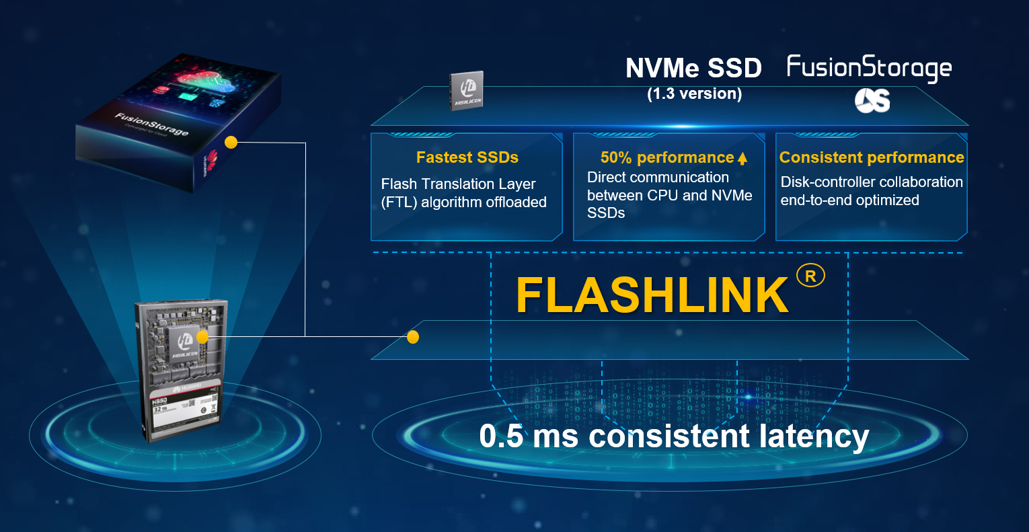
Ocean Storage 100D’s Performance Edge
Unique FlashLink® performance acceleration technology.
I/O Priority based Intelligent Scheduling
Intelligent CPU Partitioning
Intelligent Cache Algorithms
Hardware accelerators
OceanStor Dorado
Storage Features
OceanStor 100D
Performance
Usability
Data Management
Reliability
Notes:
Deep dive into I/O stack, can cut short depends on audience and time.
FlashLink is a technology that differentiates Huawei from the competition.
Huawei is one of the few Storage vendors that manufactures a SSD controllers.
End-to-end hardware stack is highly optimized.
FlashLink is built on top of this end-to-end hardware stack.
Flash is able to provide a stable 0.5-millisecond latency, meeting low latency and high-performance requirements of modern databases.
To ensure stable latency, the system prioritizes I/Os.
Based on the priorities, the system controls I/Os in terms of CPU scheduling, resource scheduling, and queuing.
System background I/Os are classified into various types: cache flushing, deduplication and compression, advanced features (remote replication and background copy), metadata merge, data garbage collection, and data reconstruction.
Intelligent partitioning algorithms include CPU grouping algorithm and CPU core splitting algorithm.
CPU grouping algorithm divides the I/Os into multiple groups to avoid mutual interference.
CPU core spitting algorithm (unique competitive advantage of Huawei) implements “Run-to-Complete” scheduling principle.
Cache efficiency is one of the key factors that determine the storage performance.
Metadata and data cache resources are partitioned to improve the metadata hit ratio.
Read data and write data are partitioned to avoid resource preemption.
Hash indexes support hot and cold partitioning to improve the search speed.
Multiple algorithms are offloaded to ARM, achieving 10% higher performance

Slide 12
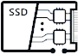
Ever Solid Applications with 5 Reliability Layers
Cloud backup
Gateway-free cloud backup
30x higher backup frequency
20x faster backup speed
99.9999%
system-level reliability
Solution
Gateway-free active-active solution (1 ms latency)
FlashEver without data migration
System
Comprehensive enterprise-class features
Tolerance for simultaneous failures of 3 disks
Reconstruction of 1 TB data in 15 minutes
99.99999%
solution-level reliability
Architecture
Tolerance for failures of 7 out of 8 controllers with SmartMatrix fully-interconnected architecture
E2E active-active design
SSD
Global wear leveling
Huawei-patented global anti-wear leveling
OceanStor Dorado
Storage Features
OceanStor 100D
Performance
Usability
Data Management
Reliability
Notes:
Our next-gen OceanStor Dorado V6 provides five levels of reliability - disk-level reliability hardening, industry-leading architecture enables industry only 7 out 8 controller failures with smart matrix technologies , system-level RAID virtualization, tolerance of three-disk failures, solution-level gateway-free active-active design, and cloud-level online and offline backup integration.
Overall it provides six-nine system-level and seven-nine solution-level protection for customer data.
Disk Level
Global wear and anti-wear leveling, LDPC+ SmartFsp 10⁻¹⁸
Data Inspection Algorithm to prevent data distortion
Disk Build-in Dynamic Raid
Architecture level
Dorado V6 implements global interconnection and load balancing through front-end sharing and interconnection, full controller interconnection, and back-end sharing and interconnection enable ultimate level of data availability
System level
fully redundant hardware design, RAID TP with rich enterprise features like three-second periodic snapshots, snapshot consistency groups, and hybrid cascaded snapshots and clones.
Solution level
HyperMetro active active DC solution with only 1ms latency, second-level snapshot, eBackup, and OceanStor DJ, implement converged data management in the DR center and on-cloud center. As a result, the system achieves minute-level reliability and hour-level DR and recovery on and off the cloud for 100% service continuity and zero data loss.
FlashEver ensure zero data migration and always on services

Slide 13
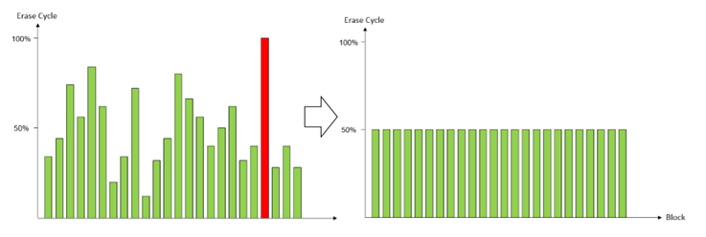
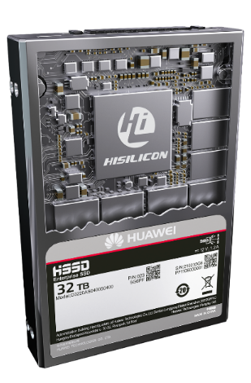
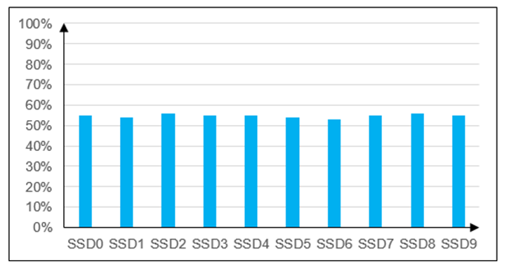
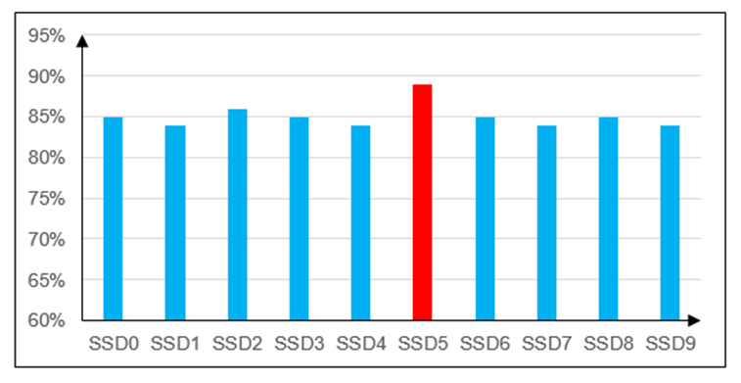
SSD-level reliability
Wearing level
Wearing level
With the global wear leveling technology, Huawei’s SSDs are wearing evenly so no HSSD is “panelized” and be forced to be replaced.
When the wearing level is over a threshold (e.g., 80%), to prevent a large set of HSSDs fail simultaneously, the global anti-wear leveling feature will start to use the HSSD with the highest wearing level heavily.
OceanStor Dorado
Storage Features
OceanStor 100D
Performance
Usability
Data Management
Reliability
Notes:
The 5 level reliability starts from the SSD reliability. Huawei designed its own SSD drive called HSSD.
HSSD provides many functions, including disk level wear leveling. The benefit of wear leveling is that customers will not see quick drive failures due to uneven wear leveling.

Slide 14
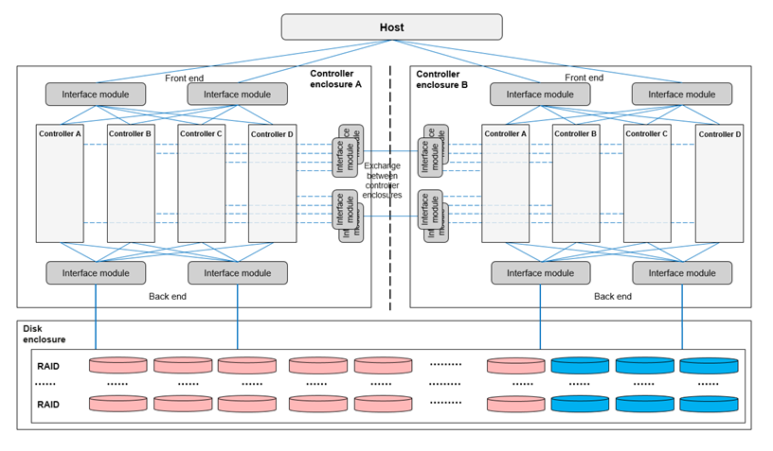

Architecture-level reliability
Tolerance of 7 controllers failure
No data loss!!
No service interruption!!
Shared Front-End
Shared Front-End
Shared Back-End
Shared Back-End
Global cache provides continuous mirroring technology
Tolerates 7 controllers failure one by one of 8 controllers(2 engines)
Smart Matrix multi-controller architecture for mission-critical models
14
FUTUREWEI INTERNAL
OceanStor Dorado
Storage Features
OceanStor 100D
Performance
Usability
Data Management
Reliability
Notes:
System level reliability is often achieved through redundancy. For example, the smart matrix multi-controller architecture is used for OceanStor Dorado V6. In each part of the design, connections are redundant, so that when one controller fails, the function of the system is not impacted.
With the support of 3 cache copies, the V6 platform supports 2 controllers fail at the same time.
On the right side, there is an animation to show that 7 controllers can fail one after another, but via the system-level reliability design, the system can still function.
Dorado V6 has the highest reliability design standard of the industry.

Slide 15
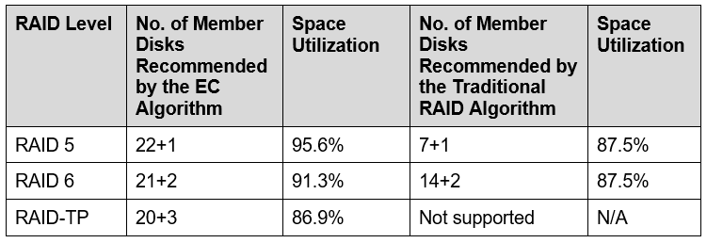
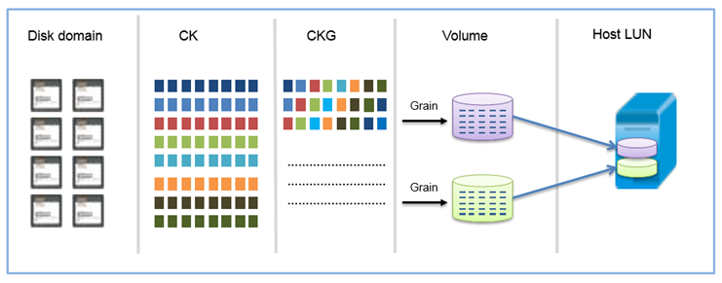
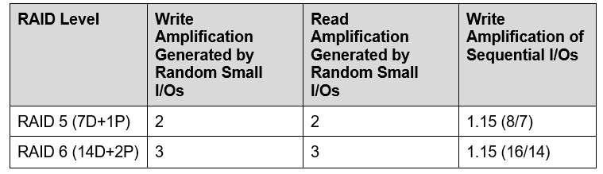
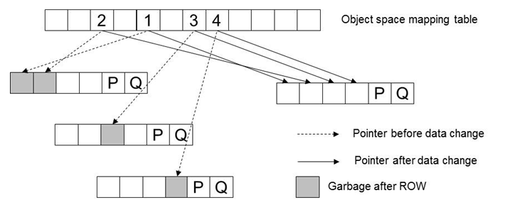
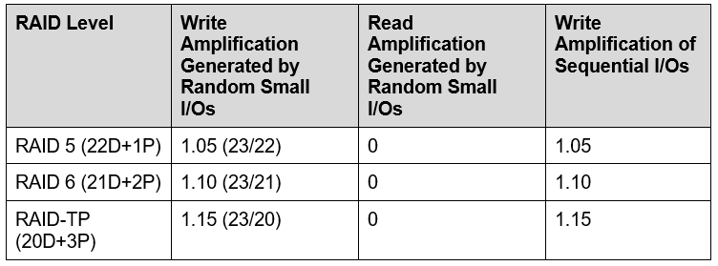
System-level reliability
Erasure coding based RAID levels
Raid 2.0
Redirect on write. No write performance penalty.
15
FUTUREWEI INTERNAL
OceanStor Dorado
Storage Features
OceanStor 100D
Performance
Usability
Data Management
Reliability
Notes:
A key aspect of system-level reliability is disk data protection.
For customers to understand this section, they need to have some basic knowledge of RAID and EC. A good reference document is the Dorado V6 system reliability technical white paper.
3 Key messages here.
RAID 2.0 technology divide the disks into small chunks, then re-arrage these chunks to form chunk groups. The host LUNs that users see are mapped to CKGs.
Compared to traditional RAID technology, which uses fixed drives to form a RAID group, RAID 2.0 disk rebuilding is much faster because all disks are involved in the process. 1TB of data can be rebuilt in 15 minutes.
In Huawei storage, erasure coding is used to implement the different RAID levels. In this table, EC has chosen 23 elements. RAID 5, 6 and Triple Parity are implemented by 22+1, 21+2, and 20+3.
Compared to traditional RAID, 22+1 vs 7+1, the space utilization is increased from 87.5% to 95.6%.
The 3rd key message is about write amplification. In the traditional RAID, data is updated in place. Therefore, both data and parity bits must be written. For RAID5, the write amplification is 2 and for RAID 6 it’s 3.
Huawei storage uses the ROW (redirect on write) technique to avoid the write penalty. The updates are written to a new stripe and only the reference points are changed to refer to new locations.
This scheme avoids the expensive update. Thus the write amplification is 1.05.

Slide 16
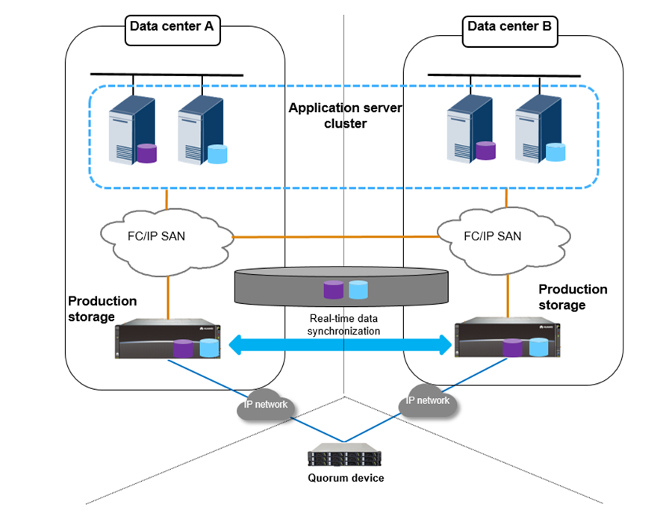
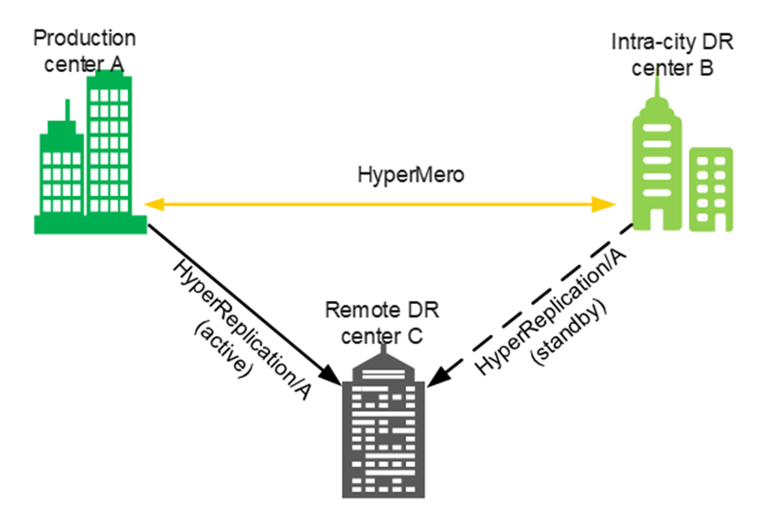
Solution-level reliability
With solution-level reliability measures, 100D can reach 99.9999% reliability and Dorado V6 can reach 99.99999%.
HyperMetro reference architecture (available on both Dorado and 100D)
3DC reference architecture
16
FUTUREWEI INTERNAL
OceanStor Dorado
Storage Features
OceanStor 100D
Performance
Usability
Data Management
Reliability
Notes:
One example of solution level reliability design is the HyperMetro active-active solution. Two systems are paired to provide near 0 RTO and zero RPO.
Sometimes 2 data centers cannot satisfy the geo-replication requirements and mult-DC solutions are needed. Here is an example about 3DC configuration.

Slide 17
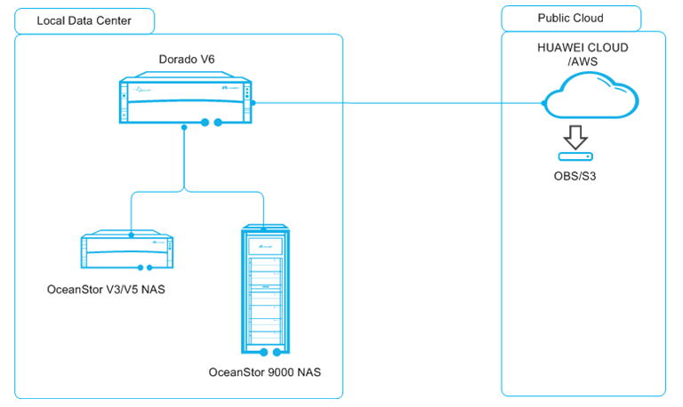
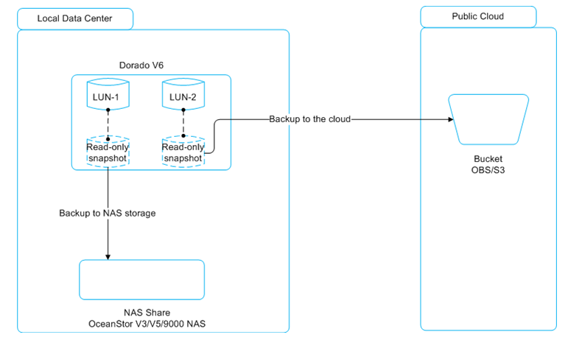
Cloud backup level reliability
Cloud backup reference architecture
Cloud backup data flow
17
17
FUTUREWEI INTERNAL
FUTUREWEI INTERNAL
OceanStor Dorado
Storage Features
OceanStor 100D
Performance
Usability
Data Management
Reliability
Notes:
The cloud backup feature can backup storage data to public clouds. Therefore, it provides another layer of reliability via multi-clouds.

Slide 18
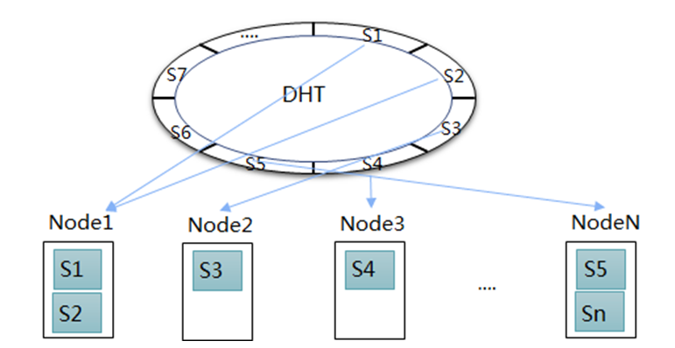
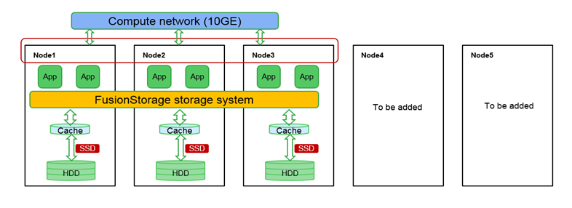
Scalability
Dorado V6 is scalable to 32 controllers, 6400 max SSDs x 30TB(SAS) = 196PB, 20mil IOPS
100D is scalable to 4096 nodes, 12TB x 12disks x 4096 = 576PB, hundreds of mils IOPS
When new nodes are added, some of the workload will be migrated to the new nodes.
Adding more nodes to 100D
Ever-new: nodes can be gradually replaced
18
18
FUTUREWEI INTERNAL
FUTUREWEI INTERNAL
OceanStor Dorado
Storage Features
OceanStor 100D
Performance
Usability
Data Management
Reliability
Notes:
In the scalability design, 100D was designed to have a better scalability than Dorado V6. Dorado V6 was designed to be tightly coupled for better performance and reliability.
When a new node is added, the system will recalculate the shard mapping. Handling of some shards will be migrated to other nodes.
Due to the use of DHT, the design is very scalable and flexible.

Slide 19
Huawei Storage: Usability, Operation Efficiency, and Automated Data Management
Key Messages:​
Huawei understood the challenges that many customers’ IT departments are facing
Budgets are not keeping pace with relentless storage growth
Huge IT operational overhead
Complex and disparate IT/storage management
Lack of skilled staffs
Ever greater enterprise internal pressures: assurance of uptime, DevOps, production, charging back, cloud integration, new technologies etc.
Huawei think a stronger storage management and automation is the key​
Huawei is deeply committed to become an industry leader in this field​​
OceanStor Dorado
Storage Features
OceanStor 100D
Performance
Usability
Data Management
Reliability
Notes:
Data growth: need for automated storage efficiency improvement and storage consolidation
Operational overhead: Intelligent O&M
Complex: unified, open interfaces to standards and other vendors,
Lack of skilled staff: ease-of
Internal pressures: Non-disruptive of everything (upgrade, expansion, migration, services), cloud-native architecture, Huawei hybrid cloud strategy
Huawei commitment: Investing in 3-layer AI-driven architecture, from chip to storage system to cloud management platforms

Slide 20
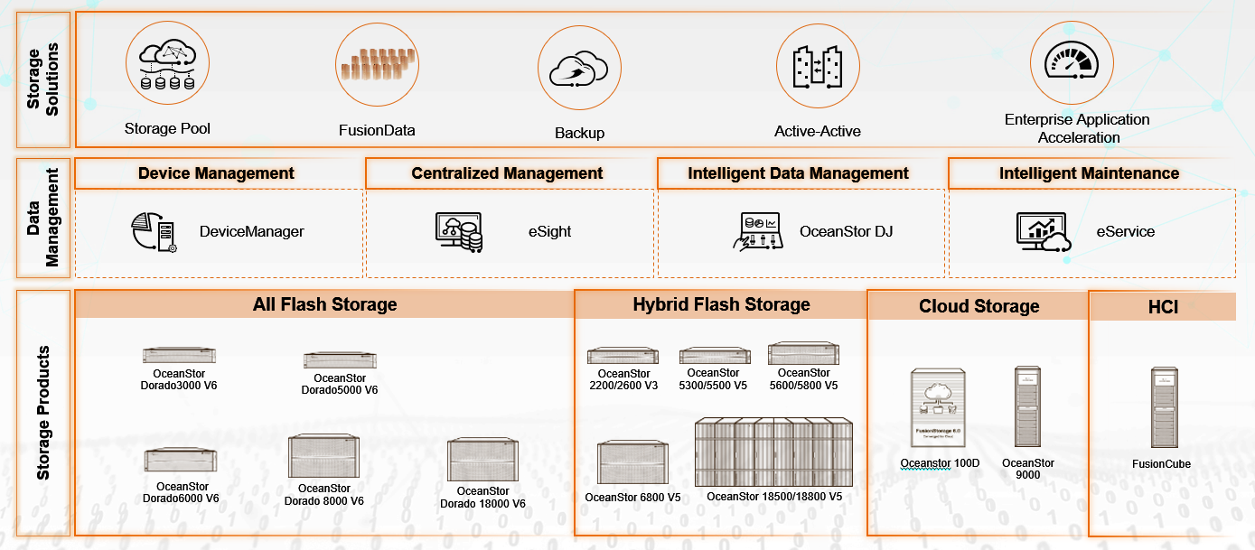
Huawei IT Storage Management Suite – Intelligent, Feature-rich, Easy-to-use, Unified, Open
DeviceManager: Embedded/unified storage system management software to provide full storage system operation capacities, and many ease-of-use features
eSight: Unified ICT management platform of different systems to ensure lower O&M costs and higher efficiency for customers.
OceanStor DJ: Powerful storage provisioning, abstraction, orchestration and automation engine, including multi-vendor support
eService: Cloud- and AIOps-based one-stop IT operation platform. Next-generation intelligent O&M platform designed around Huawei’s storage system management for self-driving autonomous systems
OceanStor Dorado
Storage Features
OceanStor 100D
Performance
Usability
Data Management
Reliability
Notes:
Intelligent: smart chips, systems, and cloud
Feature-rich: planning, deployment, configuration, provisioning, monitoring, optimization analysis, operation control, host auto discovery, centralized management in eSight, O&M, automation engine.
Ease-of: many user-friendly wizards for complex tasks
Unified: one-stop shop to manage all Huawei systems, and can extend to third-party systems via eSight and DJ
Open: RESTFUL, Industry standards (SMI-S), CLI, third-party integration

Slide 21
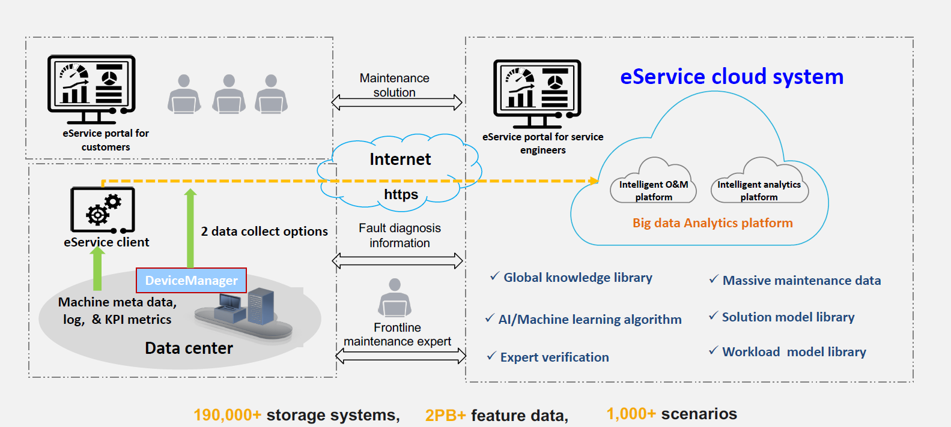
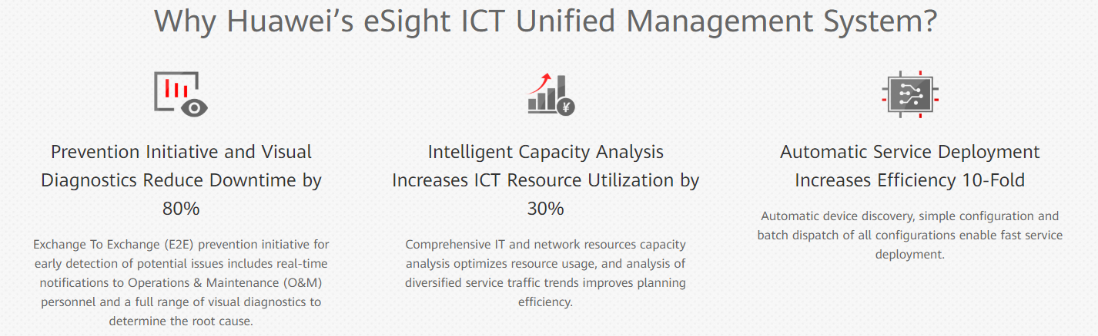
Huawei IT Storage Management – AIOps and Intelligent O&M
Key Features and Customers Benefits
Drive Failure Prediction 14 days in Advance using Huawei Developed ML/DL Algorithms:
Reduced Risk: Predict issue before it happens
Easy Drive Replacement: Replace Drives in off-peak hours to minimize business impact
Intelligent Fault Reporting and SR Creation:
Efficiency: Faults and service risks are rectified immediately
Trust: Our expert team keeps customer system up and running
Intelligent Service Planning:
Risk-free Service Changes: Based on historical performance data and AI algorithm to identify recurring patterns, recommend precise time windows that have the minimum impact
AI-Based Capacity Consumption Trend Prediction:
Cost Saving for Customers: Identify and rebalance storage to improve resource utilization rate
Reduce Operation Cost: Intelligently recommend capacity expansion solution and facilitate procurement
Security:
Information collection security, data transmission security, data storage security and data access permission security
21
OceanStor Dorado
Storage Features
OceanStor 100D
Performance
Usability
Data Management
Reliability
Notes:
Enterprises across the globe are leveraging digital technology to transform their businesses, modern enterprises must make applications assurance and uptime their No. 1 objective. Those that don’t could face catastrophic damage to their revenues and reputation.
“Mean time to repair averages 4.2 hours and wastes precious resources.” This drain of resources and finger pointing occurs as IT staff members struggle to manually correlate data
Automation will dramatically increase the number of storage systems an administrator can manage, this asks that storage management must be easier, less time consuming and more efficient.
Q: You talked about data collection through eService. What have Huawei done in eService to address customers concern on data trust, data security and data compliance?

Slide 22
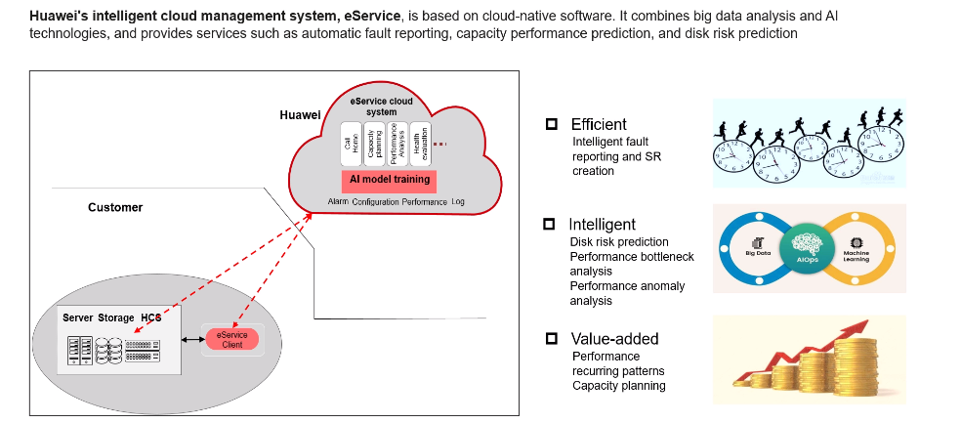
Huawei IT Storage Management – Self-Driving and Autonomous IT Operations
Face it, the complexities of storage management play to the strengths of AI, storage management largely revolves around pattern recognition, and AI can help.
Huawei is committed to continue investing in R&D, especially in the area of using Big Data and AI in storage management and self-driving IT operations, gain competitive advantage, so we can
Create added values for customers
Improve customer experience
Lower operational cost for customers
Improve storage system reliability and performance
Reduce risk exposure for customers
OceanStor Dorado
Storage Features
OceanStor 100D
Performance
Usability
Data Management
Reliability
Notes:
Huawei think AI is the key for self-driving IT operations:
The complexities of storage management play to the strengths of AI, storage management largely revolves around pattern recognition, and AI can help.
Huawei continues to build up Gartner’s recommended AIOps key capacities:
Global data ingestion and handling
Deploy AI/Big Data Analytics for event correlation, pattern discovery and prediction, anomaly detection and root cause determination.
Remediation to leverage expert knowledge database for automated action or recommended action to resolve events
Q: Disk risk prediction is quite impressive given the potential prevailing risk from drives (for e.g, same batch drives may carry similar defect and may fail at the same time, it happened at my previous job before) that may cause many drives fault at the same time, beyond EC’s ability of recovery. But for any prediction system, false positive/negative rate is major factor for the user. One can lead to waste of money and the other can lead to uncaught failure. What is accuracy on this?

Slide 23
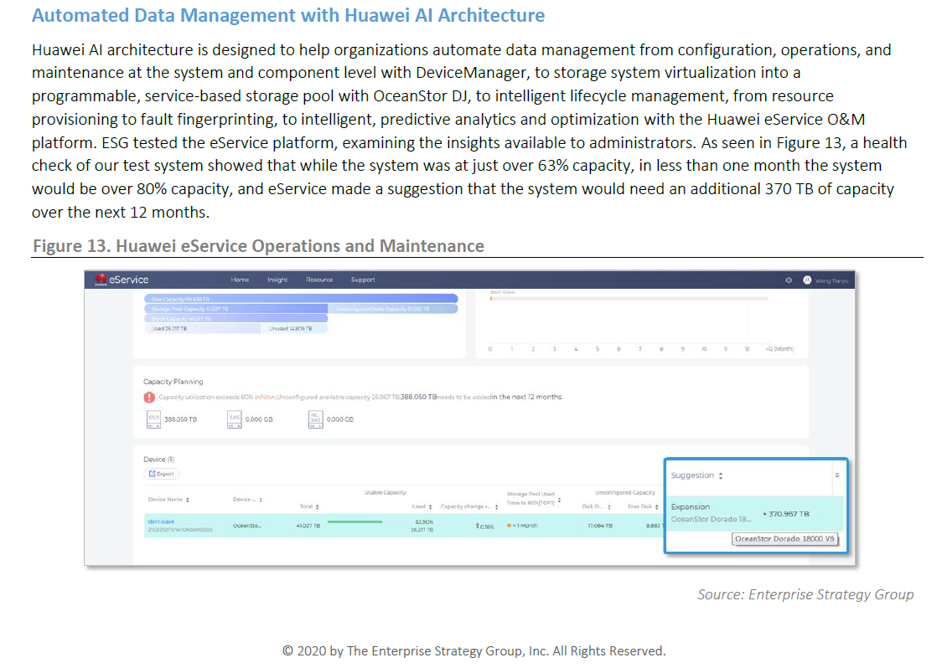
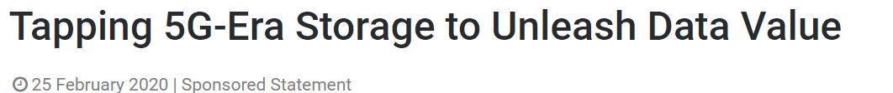
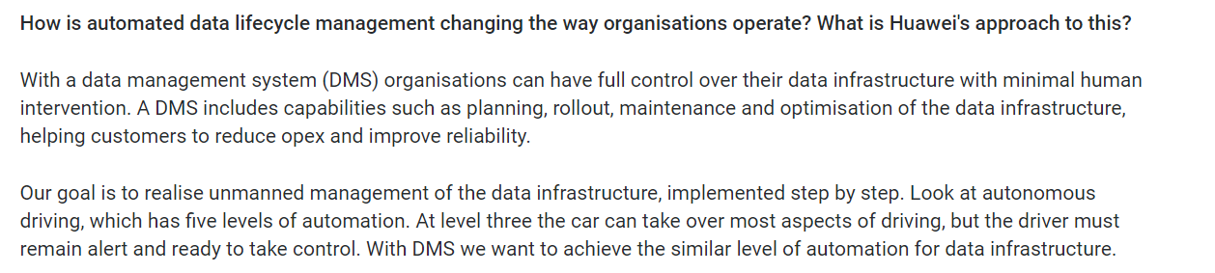
Huawei IT Storage – Automated Data Lifecycle Management: In the News
23
OceanStor Dorado
Storage Features
OceanStor 100D
Performance
Usability
Data Management
Reliability
Notes:
Capacity Media reporter interviewed Peter Zhou, President of the Intelligent Data and Storage Domain of Huawei, on February 2020.
Huawei deep commitment in Automated DMS effort
ESG-Technical-Review-Huawei-Oceanstor-Dorado-V6-All-Flash-Storage-Jan-2020
63% used capacity today, a health check (based on historic pattern not only on this system, and other similar applications) in less than a month, the system would be over 80% capacity, and eService suggested the system would need an additional 370 TB of capacity over the next 12 months
We believe AI can achieve these goals:
Increase business application assurance and uptime
Manage an integrated set of business and operational metrics
Predict and prevent outages
Dramatically reduce Mean-Time-to-Detect (MTTD) and Mean- Time-to-Repair (MTTR)
Reduce operational noise and alerts
Optimize IT and reduce IT costs by millions of dollars
Replace older, silo-focused IT monitoring tools
Auto-discover complex, heterogeneous topologies
Gain visibility into the hybrid IT environment
Accelerate migration to the hybrid cloud
Accelerate adoption of modern, dynamic IT architectures like hyperconvergence and microservices
Reduce risk in consolidating and migrating data centers
Free up resources to enable IT operations to become a proactive source of innovation
Reduce the number of IT FTEs dedicated to troubleshooting
Automate and reduce cost of audits and compliance
Simplify IT processes
Breakdown silos across their IT teams
Enable less experienced staff to become more productive, faster

Slide 24
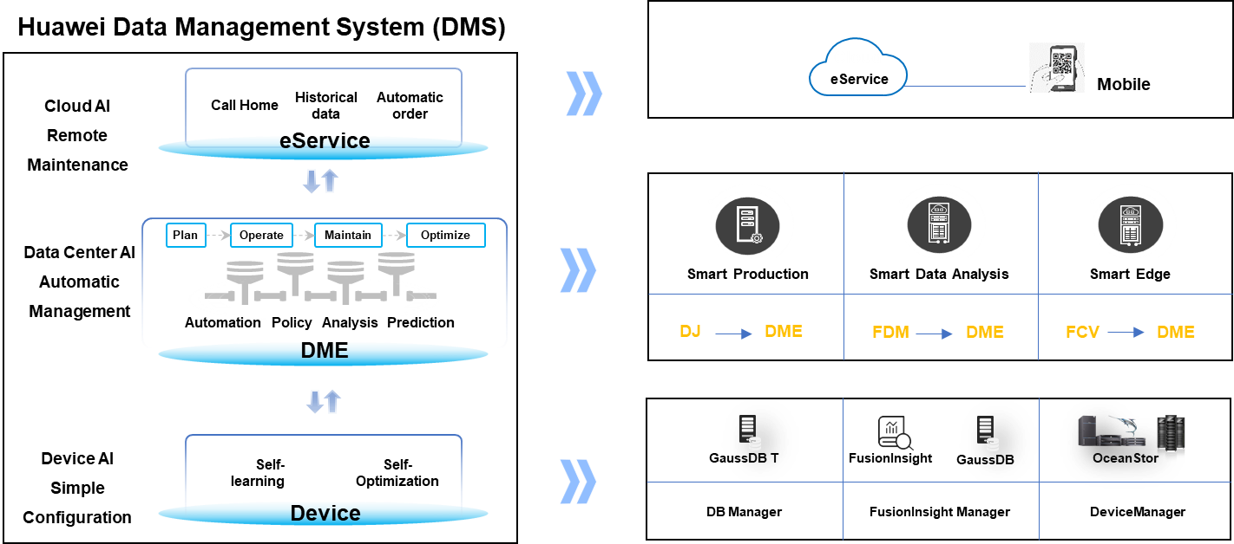
Huawei IT Storage – Automated Data Lifecycle Management: Our Path to Build
Huawei advantages
Strong commitment to R&D and future product roadmaps
AI and automation in all three layers: storage system level (DeviceManager), datacenter level (DJ) and global level (eService)
Huge amount operational data collected and gradually accumulated data management expertise, ready to unleash the full power of AI and Big Data Analytics
Global distribution of eService Cloud platform: China, Mexico and Germany service centers
Big Data for AI training: 190,000+ storage systems, 2PB+ feature data, 1000+ workflow scenarios. Just Drive Failure Prediction, we use 600, 000+ drives, 20 billion pieces of feature data, verification for 800+ days with hundreds of models
Security: information collection, data transmission, data storage and data access permission security
Battle tested with internal deployment first
Applied and improved via deploying internally first to our own datacenters and Huawei Public Cloud
24
24
OceanStor Dorado
Storage Features
OceanStor 100D
Performance
Usability
Data Management
Reliability
Notes:
3-views: system/device view, data center view, and global view
AI, Intelligent and Automations in 3 layers
System: From Smart Features to AI-based data prefetch etc. features are managed, reported, automated via DeviceManagment
Data Center: Data Management Engine (DME) in OceanStor DJ, FDM for smart data analysis, and FCV for edge
FDM: Huawei Fault Diagnosis & Management – refers to eSight platform for center monitoring and management
FCV: Huawei FusionCube Center Vision – Huawei’s edge solution
Cloud AI: Global distribution, Big Data for AI training, security in eService
Self-driving IT Operation:
Automate & Simplify: IT (storage) requires the elimination of manual operations
Sense & model the world around
Constantly learn & re-train Self-driving IT (storage) use artificial intelligence to learn from the data that they collect. As these storage are exposed to more workflows, the better that they will be able to navigate and re-training allows correction of decision making models.
Global effect Self-driving IT (storage) must also extend beyond single array optimization and deliver global intelligence.

Slide 25
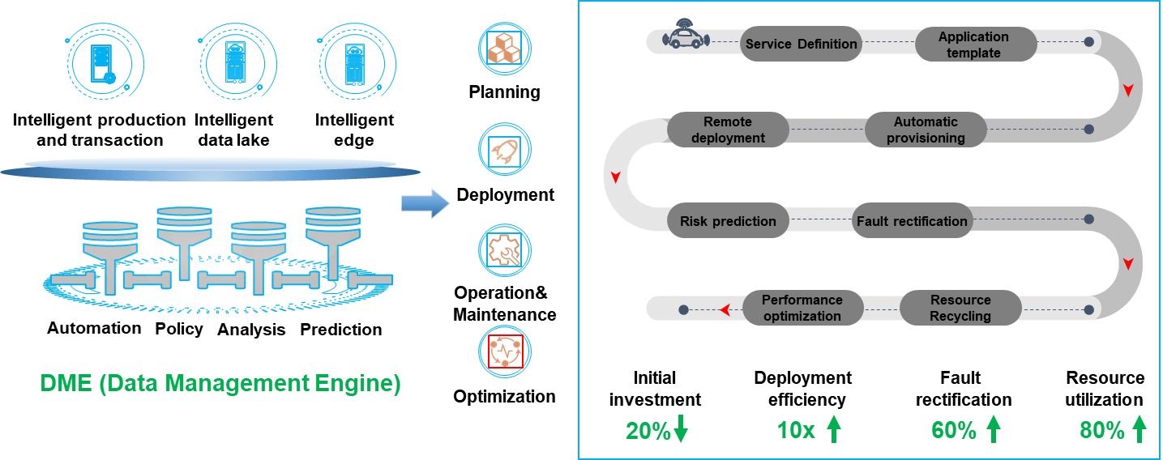
Huawei IT Storage – Automated Data Lifecycle Management: DME Enables Automatic Management
Key Features for Huawei DME:
Automation
Data Management Engine provides automatic SLA tiering, provisioning, protection, alarming, and troubleshooting for self-driving storage management throughout planning, construction, O&M, and optimization
Orchestration
DME provides end-to-end service catalogs, matches workload with optimal resources, Automatically deployment, eliminates risks, alarms, and management problems with AI models and integrated prediction, analytics, decision-making, and execution engines.
Abstractions
DME manages virtual resource pool and access third-party systems, provides comprehensive data service in backup, archive, disaster recovery.
Open
DME provides a unified interface, open APIs, AI enablement with cloud synergy, and multi-dimensional intelligent risk prediction and tuning.
25
OceanStor Dorado
Storage Features
OceanStor 100D
Performance
Usability
Data Management
Reliability
Notes:
DME automates tasks to reduce Planning, Deployment, O&M, and Optimizes storage assets to ensure maximum value
20% reduction in initial investment
10x deployment efficiency
60% improvement in fault diagnostics and recovery
80% improvement in resource utilization
Four key elements support Full-Lifecycle Data Management
Planning
End-to-end auto storage tiering based on service SLAs
Allocation
Customers just answer several simple questions, OceanStor DJ uses automation engine to orchestrate resource deployment, provisioning and hook up all connections
O&M
Proactively assess system health including capacity growth projections; Intelligently predicts risks with over a 90% accuracy from multiple dimensions, such as storage performance, capacity, and SLAs.
Optimization
Dynamically eliminates performance bottlenecks and protects service continuity with intelligent SLA adjustments.
More DME details:
Huawei OceanStor DJ provides a unified interface, open APIs, AI enablement with cloud synergy, and multi-dimensional intelligent risk prediction and tuning.
It automates intelligent management and O&M throughout the data lifecycle from storage planning, construction, to O&M and optimization, simplifying storage management and boosting operational efficiency at data centers.
It is also the core management and control plane part of the Huawei long-term strategy for SDS (Software Defined Storage), e.g. STaaS and OpenSDS, which can abstract from hardware storage, either on-premise or in cloud, then become a shared pool that is unrestricted by physical systems, thereby improving resource utilization. DJ can be deployed and provisioned based on software management, and simplified using policy-based automatic management.

Slide 26
Overall Architecture of Huawei Storage System
Protocol
FlashLink
NVMe
VBS (SCSI/iSCSI)
NAS
HDFS
S3/SWIFT
Disaster Recovery
HyperReplication
HyperMetro
O&M Plane
Cluster Management
DeviceManger
QoS
License/Alarm/
Log
Authentication
eService
Block
LUN Volume
L1 Cache
File
DriectIO L1 Cache MDS
HDFS
NameNode
Object
LS OSC Billing
Metadata
Index Layer
Write Ahead Log Snapshot Compression Deduplication Garbage Collection
Backend
Persistence Layer
Mirror Erasure Coding Raid 2.0 Fast Reconstruction Write-back Cache SmartCache
Hardware
Kunpeng SSD AI Chips Smart DAE BMC Chip NIC
OceanStor Dorado
Storage Features
OceanStor 100D
Performance
Usability
Data Management
Reliability
Review
Notes:
Enabled by shared 3 layer architecture, OceanStor 100D and Dorado v6 offer rich enterprise features with ultra scalabilities.
Powered by flash link algorithms and end to env NVME, they are delivering unparallel performance.
With SmartMatrix technologies, they are able to offer ultimate reliability without compromise.
Intelligent O&M software suite at different level provide customer cost effective and efficient O&M solutions.

Slide 28
Backup Materials

Slide 29
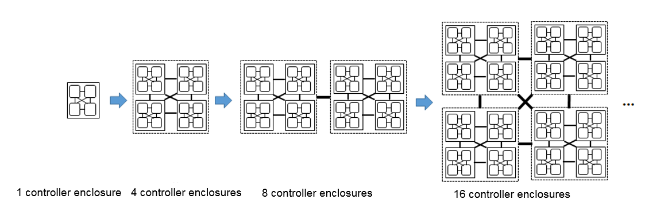
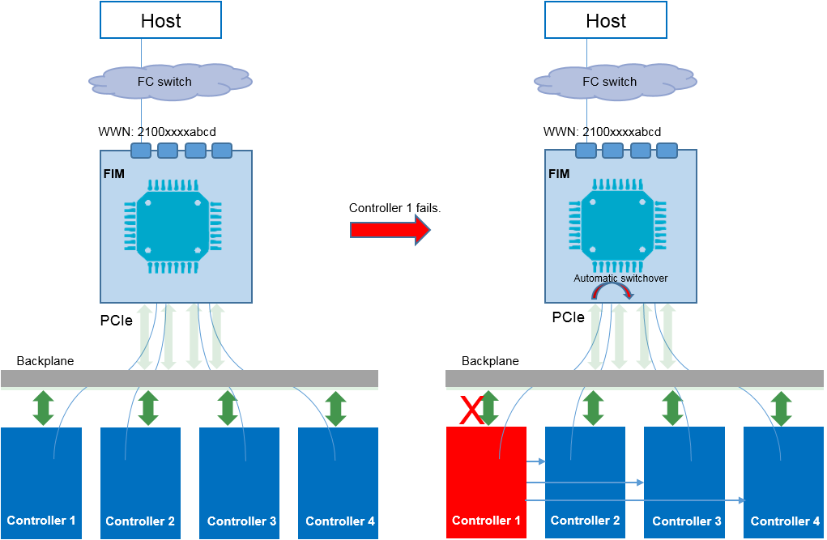
Full-mesh Balanced Architecture & Shared FIM

Slide 30
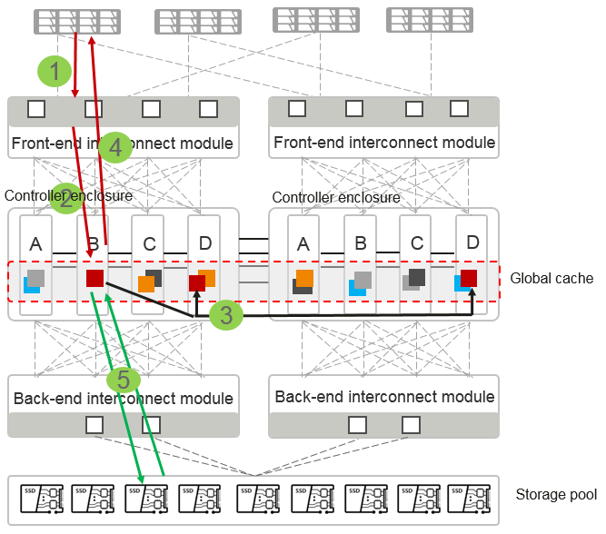
Global Cache

Slide 31
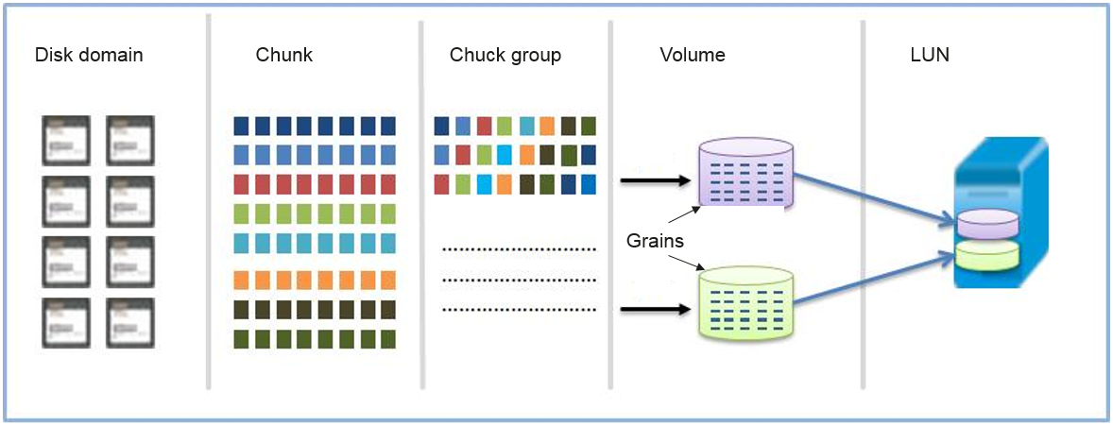
RAID 2.0+

Slide 32
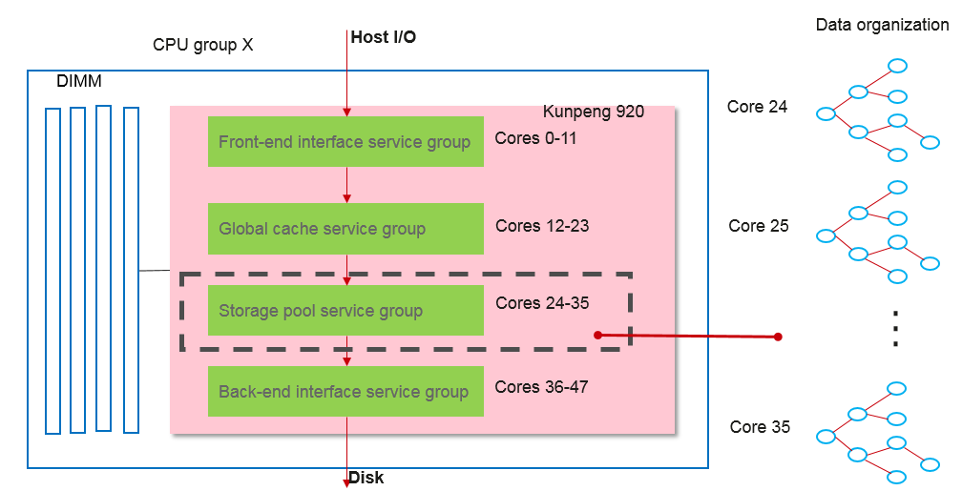
Lockfree IO handling

Slide 33
E2E Reliability Design Providing Continuous High Availability
Patents
Reliable Manufacturing
Reliable Component and Node
Reliable Cluster
Reliable DC
Reliable O&M
Supplier qualification management
Anti-interference design
Full-redundancy architecture
Active-Active configuration
Inspection and alarm reporting
Premium components
Operating environment monitoring
Fault domain isolation
Remote asynchronous replication
Upgrade/Replacement management
Reliability interception and test
Disk reliability
Cabinet-level data security
Private cloud backup
Human error prevention and recovery
Long-time scrolling reliability testing
Sub-health management
Fast data reconstruction
Public cloud backup
Fault demarcation and location
Huawei production and test
Quick node fault detection
E2E checksum
Emergency service recovery
Failure analysis and warning
Software reliability
QoS and overload control
Emergency data loss recovery
Interoperability authentication
Fault detection, self-healing, and isolation
Virtual snapshot
Reliability test and authentication
Fault prediction
Periodic background validation
ReadyNode
premium components
Hi 1616
Hi 1812
Hi 1822
Hi 1720
2 U
4 U
Chips: Four types of Hi series customized chips: processor, storage media, network, and management
Self-developed ultra-fast media: NVMe SSD disks and cards
Node: FusionServer V5, TaiShan series

Slide 34
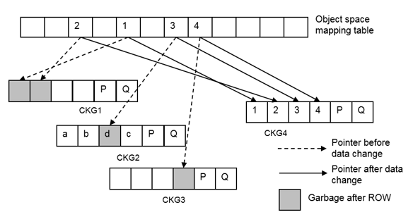
ROW (Redirect on Write) Full-stripe Write

Slide 35


Multi-streaming

Slide 36


E2E IO Priority

Slide 37


Smart Disk Enclosure

Slide 38

Leverage AI Technology

Slide 39

Smart Dedup & Compact

Slide 40


Smart Storage Virtualization

Slide 41

Smart Thin Provisioning

Slide 42












FlashLink: End-to-End All-Flash Optimization for Mission-Critical Workloads
NVMe SSD
(1.3 version)
One DC,
One
Storage
Fastest SSDs
50% performance
Consistent performance
Flash Translation Layer (FTL) algorithm offloaded
Direct communication between CPU and NVMe SSDs
Disk-controller collaboration end-to-end optimized
Data-Migration-Free
Storage
FLASHLINK
R
Self-driving
Storage
0.5 ms consistent latency
Notes:
FlashLink is a technology that differentiates Huawei from the competition.
Huawei is one of the few Storage vendors that manufactures a SSD controllers.
End-to-end hardware stack is highly optimized.
FlashLink is built on top of this end-to-end hardware stack.
Flash is able to provide a stable 0.5-millisecond latency, meeting low latency and high-performance requirements of various databases.

Slide 43



高效能
——端到端性能加速
100%
业务处理速率
业界 华为
10GE/25GE 100GE
18核2.8GHz 48核2.6GHz
16 channel 32 channel
接口速率4X
CPU核数2X
缓存通道2X
写时延30μs
读时延90μs
写时延14μs
读时延80μs
SSD时延30%
Notes:
为什么我们能实现端到端的性能加速，这是因为我们有智能的4颗芯片。
智能处理器芯片鲲鹏920 （内部型号Hi1620）是业务最高性能的ARM-based CPU；
智能多协议接口芯片，实现协议硬件卸载，加速前端访问，时延降低10%；
智能SSD控制芯片加速SSD盘内数据访问，读时延达到业界最短的80μs；
BMC管理芯片实现对CPU、内存等部件管控，故障恢复时间从2小时缩短到10分钟

Slide 44





高效能
——端到端性能加速
传
算
存
管
融合网络芯片
鲲鹏920 控制器芯片
SSD控制器芯片
智能管理芯片
协议硬件卸载，加速前端访问速度
自研7nm
读写IO处理加速
多接口、多介质支持
性能业界领先 | 可靠性No.1
精细化设备监控 | 故障切换
内置加密引擎安全接入
Notes:
为什么我们能实现端到端的性能加速，这是因为我们有智能的4颗芯片。
智能处理器芯片鲲鹏920 （内部型号Hi1620）是业务最高性能的ARM-based CPU；
智能多协议接口芯片，实现协议硬件卸载，加速前端访问，时延降低10%；
智能SSD控制芯片加速SSD盘内数据访问，读时延达到业界最短的80μs；
BMC管理芯片实现对CPU、内存等部件管控，故障定位准确率提升到93%

Slide 45
Dedicated Kunpeng Hardware Provides Optimal User Experience
Dedicated hardware
The core binding mechanism improves performance by 20%
Multiple algorithms are offloaded to ARM, achieving 10% higher performance
FlashLink enables 0.5 ms ultra-low latency
Higher performance
Over 15% higher performance than x86 when using the same power consumption
4 U
2 U
More solid reliability
Complete hardware fault detection and isolation
DIF data integrity protection
Comprehensive subhealth check: Network, storage, computing, and process
Fine-grained I/O performance statistics
Category | F series | P series | C series
Description | Ultra-high performance | Performance-oriented | Capacity-oriented
Height | 2 U | 2 U | 4 U
CPU | Kunpeng/x86 | Kunpeng/x86 | Kunpeng/x86
Better compatibility
Integrated deployment and delivery
Clear fault demarcation
Component quality assurance thanks to strict control and testing of incoming materials

Slide 46
FusionStorage uses unique FlashLink® performance acceleration technology, intelligent stripe aggregation,
I/O priority scheduling,
cache algorithms,
data identification and processing,
and NVMe SSD caches to deliver 1 millisecond stable latency, even when data reduction is enabled. FusionStorage satisfies your I/O-intensive, latency-sensitive, and capacity-hungry needs and is ready to supercharge your business of today as well as that of the future.
NVMe All-Flash Architecture
CPU and SSD directly communicate with each other to shorten the transmission path.
Number of concurrent requests is increased by 10 times to improve the performance.
Number of protocol interactions is reduced from 4 to 2. (write request processing efficiency is doubled).

Slide 47

DeviceManager: Native Built-in Device Management

Slide 48

eSight: Data Center O&M Management Platform

Slide 49

OceanStor DJ: Storage Automation & Provisioning Service Engine

Slide 50

eService: AI-based Intelligent Operation Services Platform

Slide 51

Huawei IT Storage – Automated Data Lifecycle Management: Save OpEx up to 60%
Four key elements support Full-Lifecycle Data Management
Planning
End-to-end auto storage tiering based on service SLAs
Allocation
Customers just answer several simple questions, OceanStor DJ uses automation engine to orchestrate resource deployment, provisioning and hook up all connections
O&M
Proactively assess system health including capacity growth projections; Intelligently predicts risks with over a 90% accuracy from multiple dimensions, such as storage performance, capacity, and SLAs.
Optimization
Dynamically eliminates performance bottlenecks and protects service continuity with intelligent SLA adjustments.
Notes:
Key points:
Customers can just answer some simple questions to define policy they desired, Huawei software will auto cerate related storage objects, data protection, performance SLA, and make storage resources live and ready to serve
This is a simple example, but could be extended to more complicated cases, even involving orchestration of third-party storage systems and cloud resources.

Slide 52

Huawei IT Storage – Automated Data Lifecycle Management: A Converged, Intelligent, Open Data Infrastructure
Converged
Single source of truth for data
Intelligent
Through Automation Life Cycle management, intelligent data management system, planning, allocating, maintaining and optimizing of storage resource are fully automated, improving management efficiency by 5 times
Open
By using open data engine we can realize one directory, one interface, and one copy of data to largely simplify the big data architecture. Data integration efficiency is greatly improved. 80% of analysis time for business launching can be saved.
Notes:
DMS concentrates on reducing OpEx by using AI to automate storage management
Already seen AI in eService, DJ, and in-system behind Device Manager
Now, DME automates tasks to reduce Planning, Deployment, O&M, and Optimizes storage assets to ensure maximum value
20% reduction in initial investment
10x deployment efficiency
60% improvement in fault diagnostics and recovery
80% improvement in resource utilization

Slide 53
Flashlink™ Key Functionalities for Future
Features | Details | Performance | Reliability/life/Economy
SmartMatrix | Multi-controller protection |  | Good scheme to detect, rectify and isolate failures.
Auto Load Balancing | Global load balance. | IO is forwarded to optimal ctlr | Achieve nature failure avoidance.
 | Global Cache & 2/3-copies | Combine all ctlr cache for better perf | Avoid single point failure.
 | Raid2.0+ | Auto load balance to all drvs in grp Flexible configuration, high per | Reduce chance of single SSD Failure. Fast recovery allows large drive (4TB).
Intelligent Multi-core Tech | CPU Grouping | Avoid CPU access remote mem and inter CPU comm. Improve Perf!
 | Service Grouping | Difference service run on diff cores.
 | Lock Free IO handling. | Dedicated cores running storage IO
ROW Full Strip Write | ROW (Redirect on Write) | Reduce write amplification for better write performance. | Reduce write amplification, extend SSD life.
Global Wearing & Anti-wear leveling | Smart wearing control through SSD life time. |  | Global leveling to enhance life. Anti-leveling at end to allow SSD replace early in time.
Multi-Streaming | Stream hot/cold together | Perf is better for less write amplification | SSD life is better for less amplicaition.
E2E IO Priority | Allow read interrupt wrt | Low read latency and better perf
Smart Disk Enclosure | Offload smart disk recovery | Ensure etter performance at controller. | Dynamic recovery ensure protection w/t less disk
AI Tech | Intelligent Cache Read | Predict IO pattern to enhance hit rate. | Better service quality
 | Intelligent QoS | Ensure up performance for critical service
 | Data Reduction | Coordinate inline/offline dedup
OceanStor Dorado
Storage Features
OceanStor 100D
Performance
Usability
Data Management
Reliability
Notes:
These functionalities are the fundamental buidling block for the outstanding performance and reliability of Huawei Storage.

Slide 54
Smart Storage Service Features for Future
Featres | Details | Performance | Reliability/life/Economy
SMART Dedupe & Compression | Adaptive deduplicate and compress data footprint to increase storage usability |  | Enhance virtual capacity.
 | Similarity Based Deduplication | Maximized the deduplication performance | Similar fingerprint(SFP) based for good deduplication ratio
 | Inline & post-process compression |  | Balance real-time efficiency with best long run capacity utilization.
SMART QoS | Burst control & low limit guarantee of IOPS, latency | Ensure critical service meet defined performance | Guarantee the reliability of performance.
SMART storage Virtualization | virtualization for heterogeneous storages. | Support online takeover. | Best for 3rd party collaboration and co-operation.
SMART Migration | Allow migration happens without interrupting on-going service. | Ensure the data service performance | Enhance data protection to allow migration happens at all time.
SMART thin provisioning | Dynamically allocate resource on demand |  | Allow better utilization of storage resource.
SMART Erase | Follow standard defined or user defined various disk erasure policy to guarantee data cleansing. |  | Guarantee the safe re-use of the resource and for data protection.
OceanStor Dorado
Storage Features
OceanStor 100D
Performance
Usability
Data Management
Reliability
Notes:
These are the key storage S/W features.
Similar Fingerprint (SFP) algorithm is like to identifying number of same words in different sentences to check the effective of data duplication.
Adaptive Deduplication relies on SFP result to decide of inline deduplication is viable or it worth to do offline.

